Slide 1

Day performance similarities of multiple listed companies
and their possible use for a day trading strategy
Stefan Hainzer, July 2017

Slide 2
Multiple Listed Companies
Companies which are listed on more than one stock exchange.
There is a legal difference between cross-listed and dual-listed companies, but this is not considered in this case study.
If the stock exchanges are in different time zones then the shares are traded two times in 24 hours.
For this case study I used stock data of six companies which are listed in New York and Bombai (India).

Slide 3
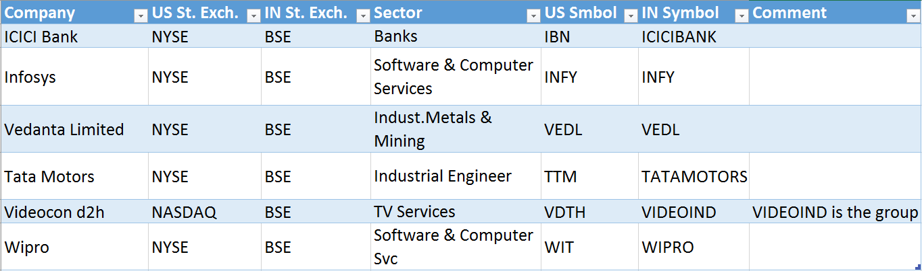
Companies
Daily stock prices of the last 10 years can be downloaded from the stock exchange web sites.
Joined the data together where the trading days are within 24h.
There are two possilble directions IN -> US and US -> IN.

Slide 4
Day Performance, Trading Model Assumptions
The day performance is calculated in the following waý: (Closing_Price - Opening_Price) / Opening_Price
If we decide to trade a stock on a specific day then we assume that we can buy the stock with the opening price and sell with the closing price, so the trading performance is the same as the day performance of the stock.
We always sell the stock at the end of the day, we hold no stocks overnight.
We trade a stock if the day performance of the remote stock exchange was positive.

Slide 5
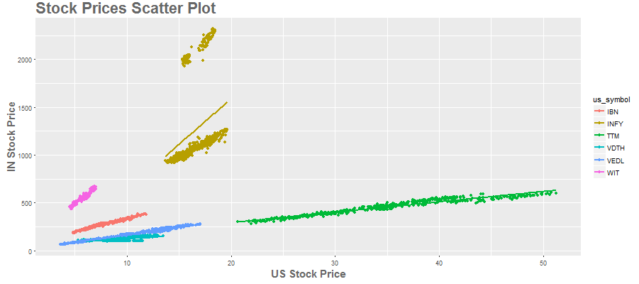
Correlations of stock prices
Stock Prices Scatter Plot 2015/01 – 2017/07:
The stock prices are strongly correlated.
If there appear two clusters for one stock (Infosys) then a stock split has taken place.

Slide 6
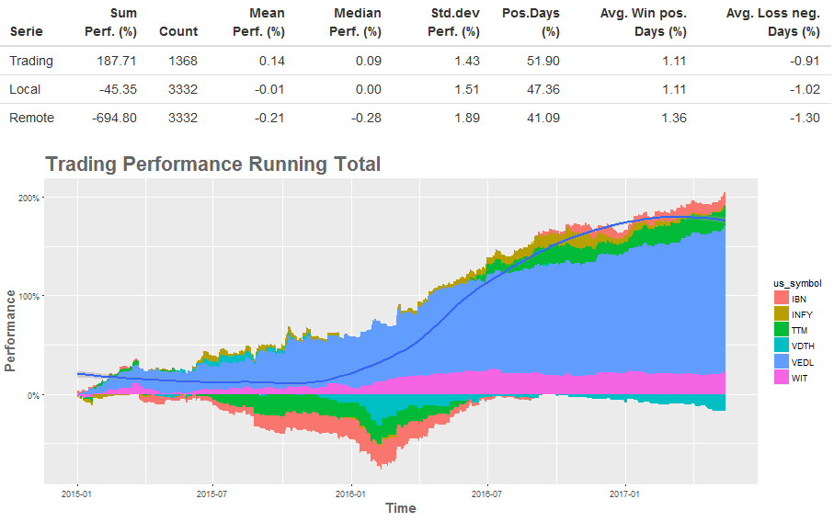
Day Trading Performance (IN->US)

Slide 7
Day Trading Performance / Findings
Overall the trading was profitable (188%).
Not all stocks have been positive, some changed behaviour, some are negative.
For a more detailed analysis a sliding correlation was implemented.
For each day with data the correlation of the day performances of the 60 previous days were calculated.
In the following we show different types.

Slide 8
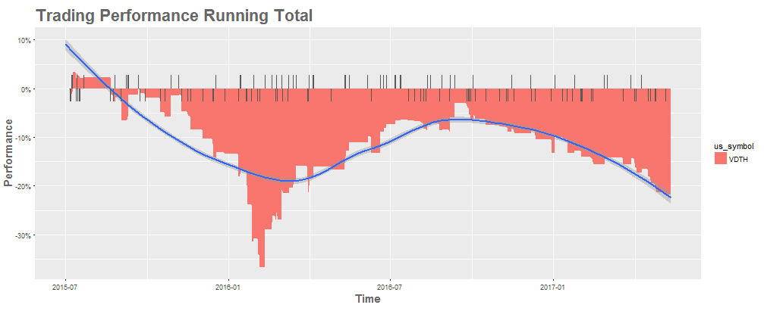

Trading Performance: „Loser“
The trading performance of Videocon d2h is very bad.
The overall correlation in the time period is to low:
No candidate for our trading model!

Slide 9
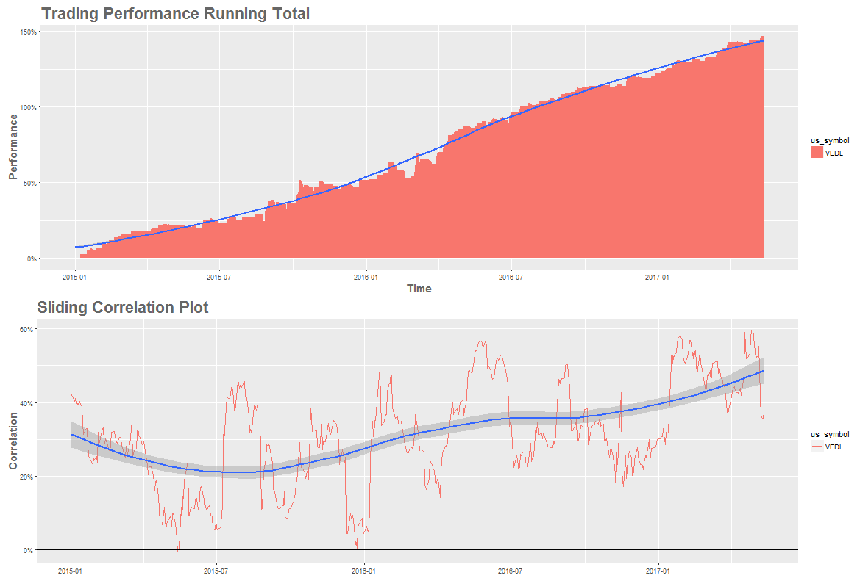
Trading Performance: „Star“
Vedanta Limited:
Strong correlation throughout.
Total day performance correlation is 29%.
Moneymaker!

Slide 10
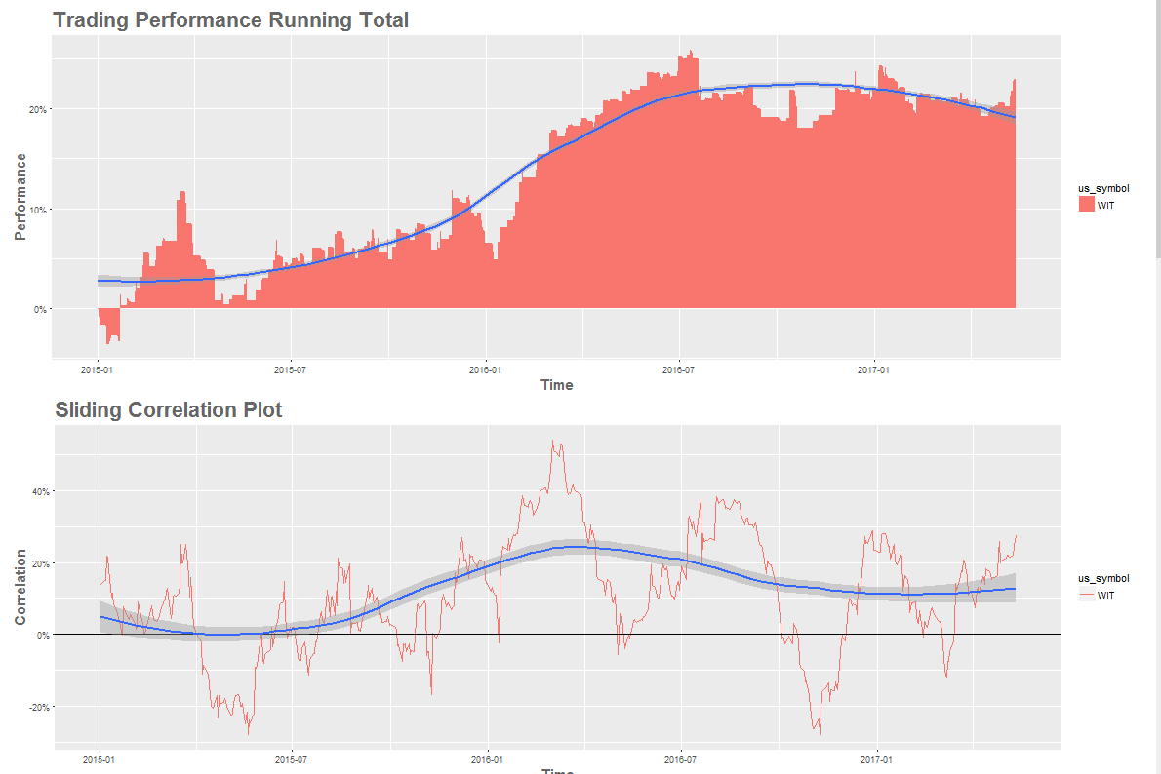
Trading Performance: „Lame Duck“
Wipro:
Good start but no gain since 2016/7.
Horizontal movement.
Day performance correlation got to weak.
Pause while lame / further analysis.

Slide 11
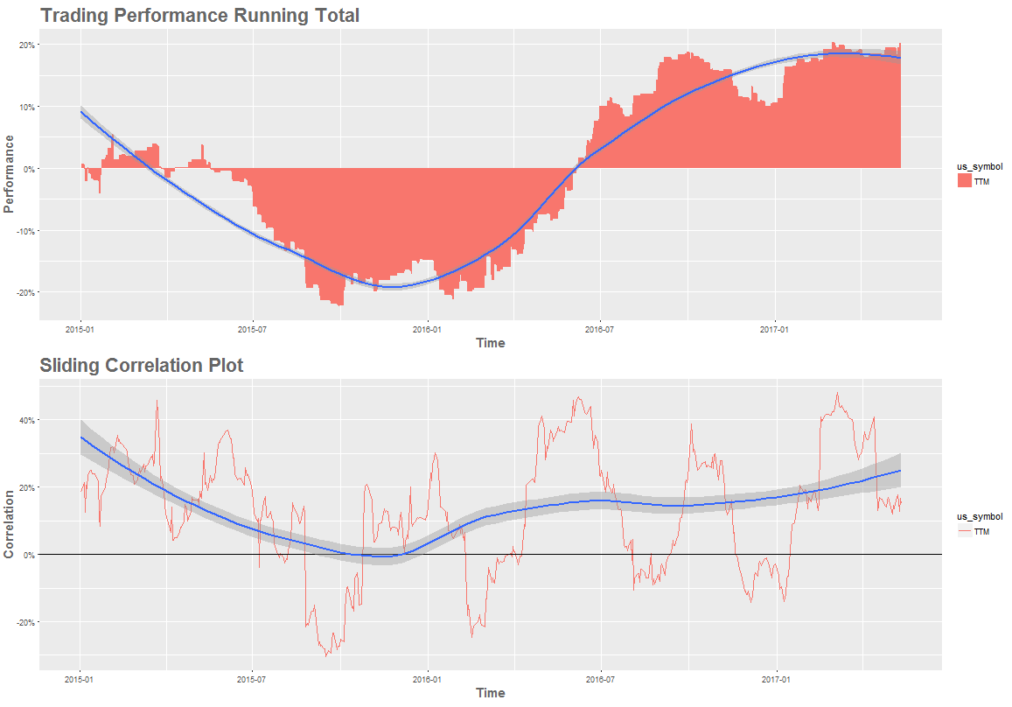
Trading Performance: „Flakey Jerk“
Tata Motors:
Long periodic negative correlation phases.
Try to detect and avoid negative correlation phases.
More analysis.

Slide 12
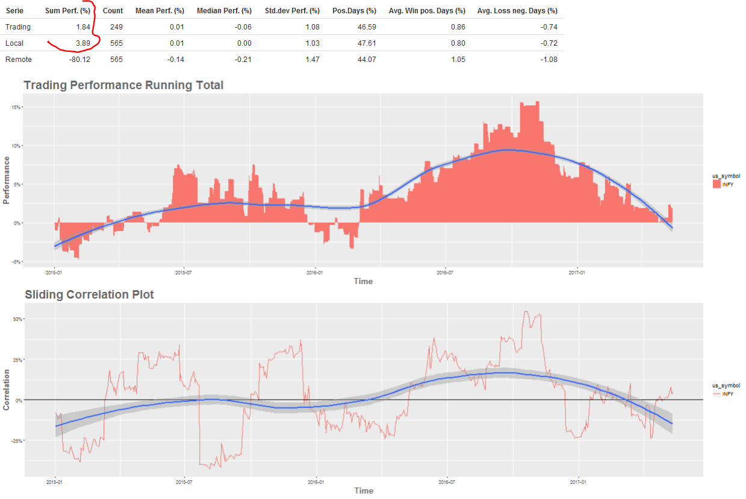
Trading Performance: “Dazzler”
Infosys
Seems to have a positive correlation, but the trading perf. is smaller than the every-day-trading performance.
The trading strategy has no positive effect.
Positive result is just luck.
Remove and observer future development.

Slide 13
Conclusion
Some multiple listed companies show a useful and valuable correlation of their day performances.
The day performance correlation is much weaker than the stock price correlation and varies over time.
To gain profit the correlation must stay over 10-20% in the observed time-span and there have to be enough buying signals (remote performance > 0).
Further analysis to detect the current correlation level could yield to a better trading model.

Slide 14
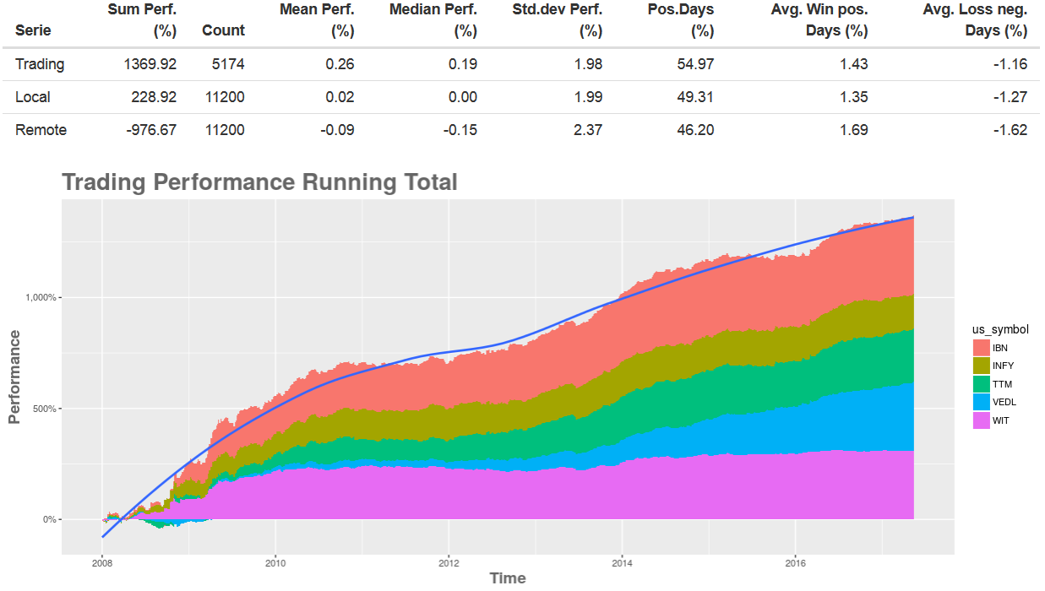
10-Year Performance

